Slide 1
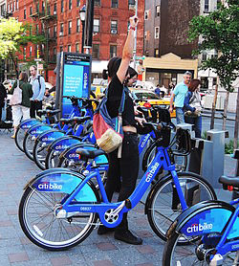
CIS 4560 Big Data Analysis
Citi Bike Dataset and Setup
By Steven Hoang, Thanh Tu, Dat Le, Rafael Reyes, James Wu

Slide 2
Overview of the Project
We will be analyzing the dataset of the Citi Bike biking service and briefly compare it to Cars for Hire in the same years.
The purpose of this project is to learn:
Where the stations are located
How long do they ride
Most popular bike stations and etc.
The dataset of this project is 1 gigabyte

Slide 3
H/W Experimental Specifications
We will be using BlueMix’s BigInsight clusters
The version we will use is IOP 4.2, Number of nodes is one for both management and data, 1 terabyte of storage memory and 4 VCPU core speed.

Slide 4
Obtaining the dataset from Amazon Web Services
The link that our group is using comes from: https://s3.amazonaws.com/tripdata/201307-201402-citibike-tripdata.zip
The data shows up as 178.26 MB unextracted from the archive but becomes around 1 gigabyte in size.

Slide 5
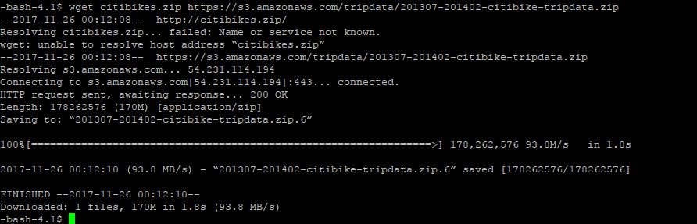
Downloading the Citi Bikes Zip

Slide 6
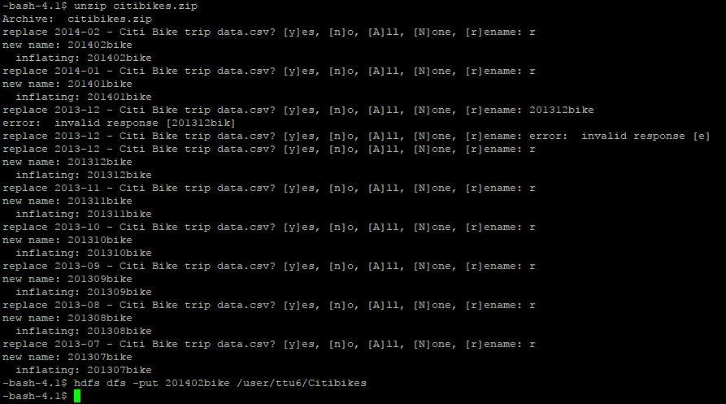

Slide 7
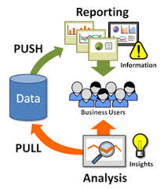
Deliverable
We will be delivering the insight
The way we will be doing this is by pulling the data from Amazon Web Services and analyzing the data through Hive and Pig to provide business users the insight of this data.

Slide 8
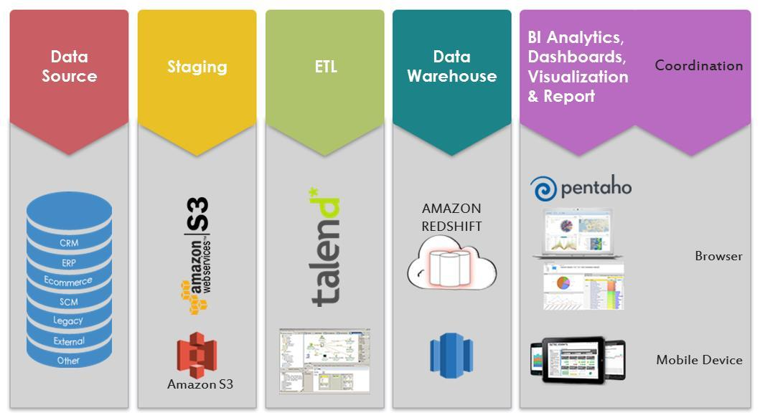

Slide 9
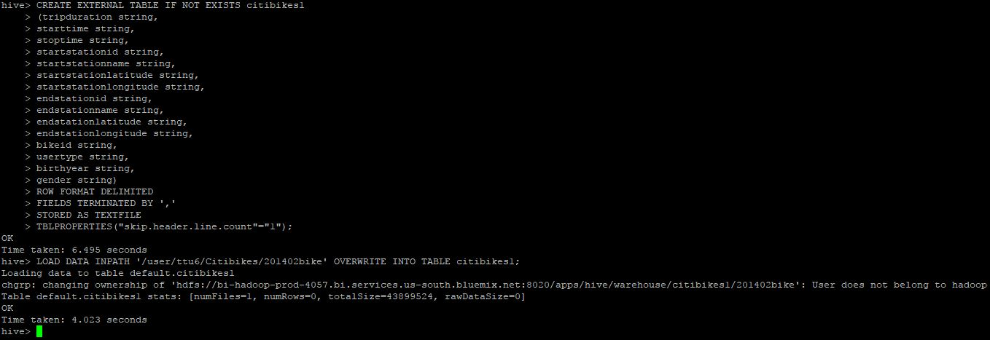
Creation of the table example

Slide 10
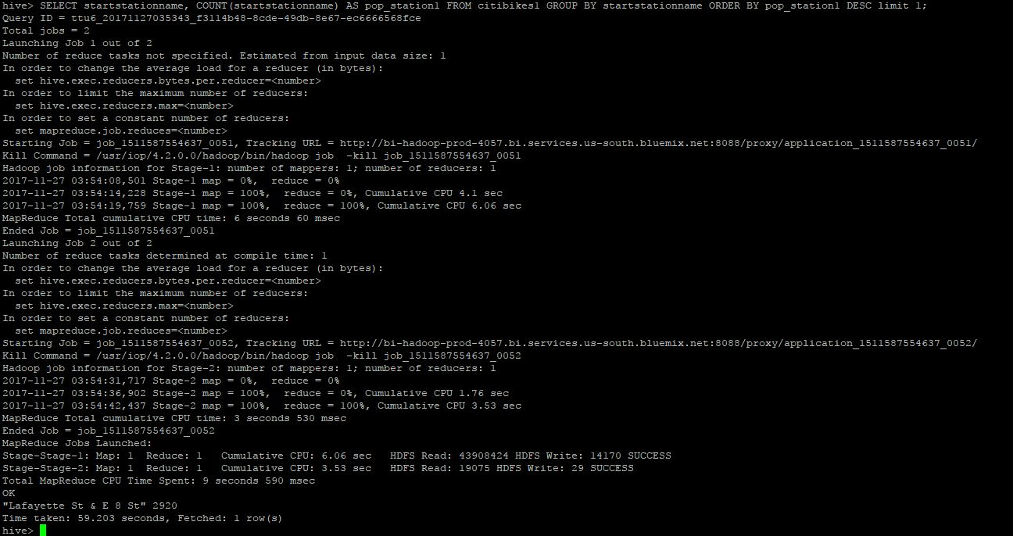
Hive Analysis Popular Stations 02/2014 (Start)

Slide 11
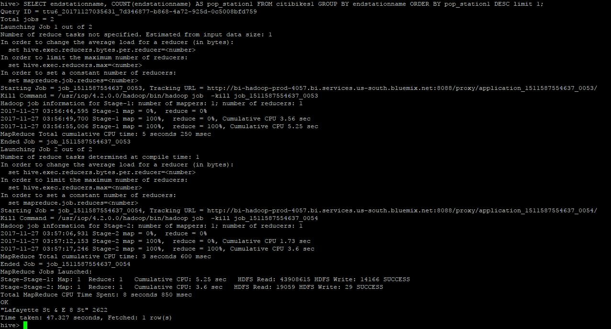
Cont. (End)

Slide 12
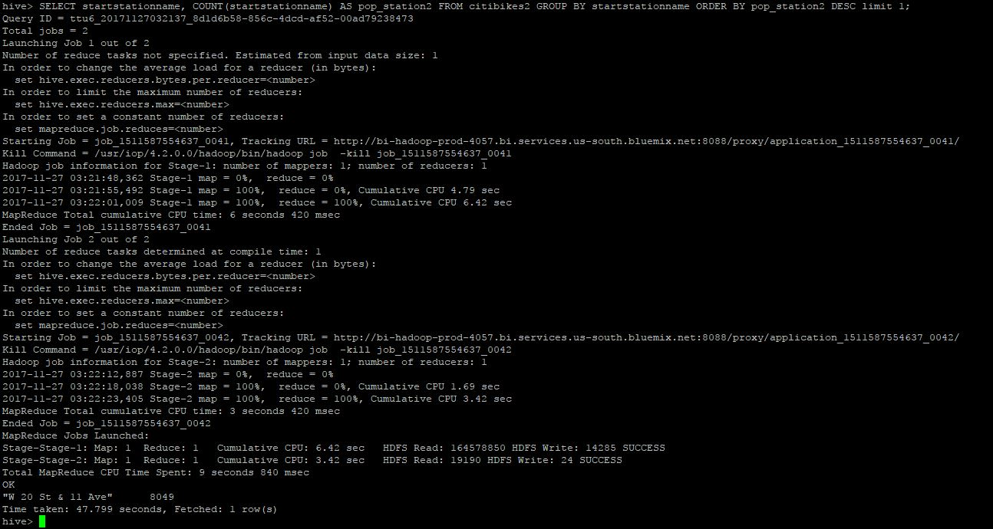
Hive Analysis Popular Stations 07/2013 (Start)

Slide 13
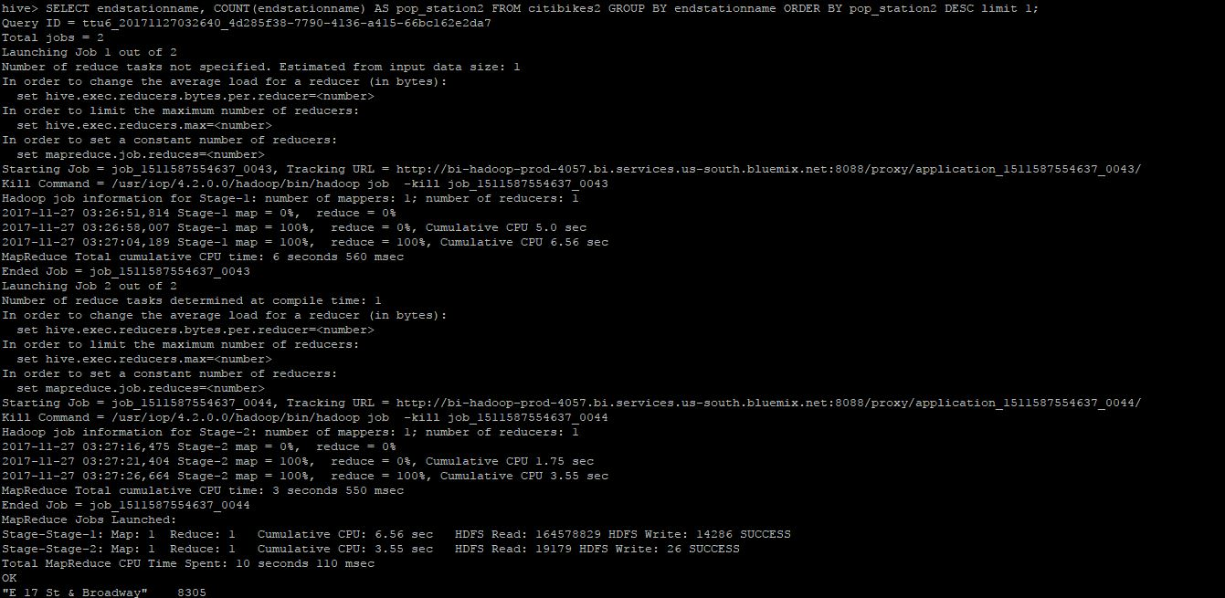
Cont. (End)

Slide 14
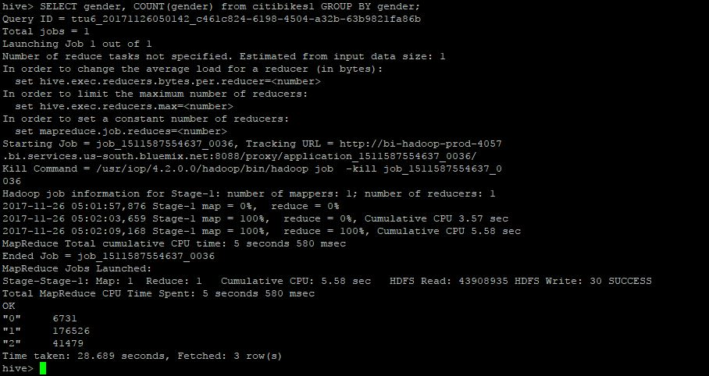
Hive Analysis Gender Count 02/2014

Slide 15
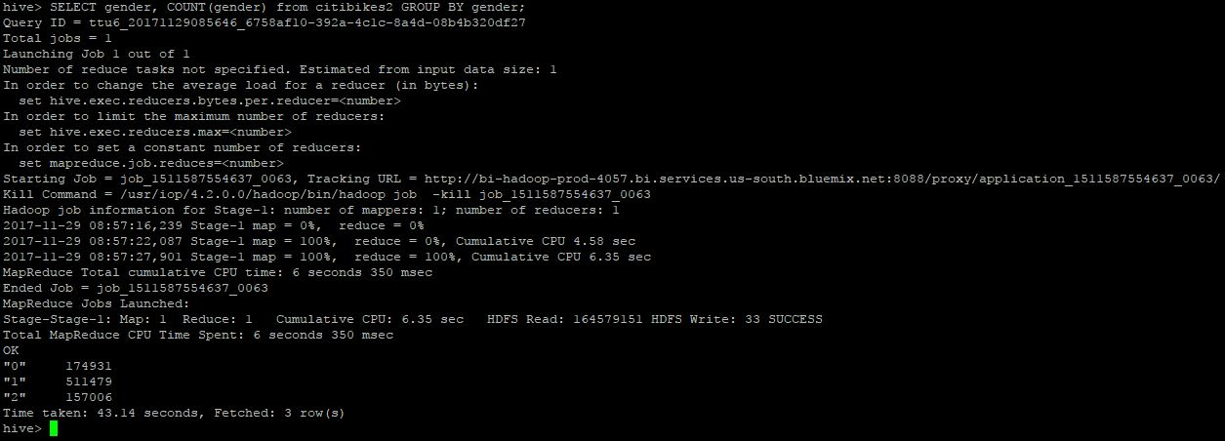
Cont. 07/2013

Slide 16
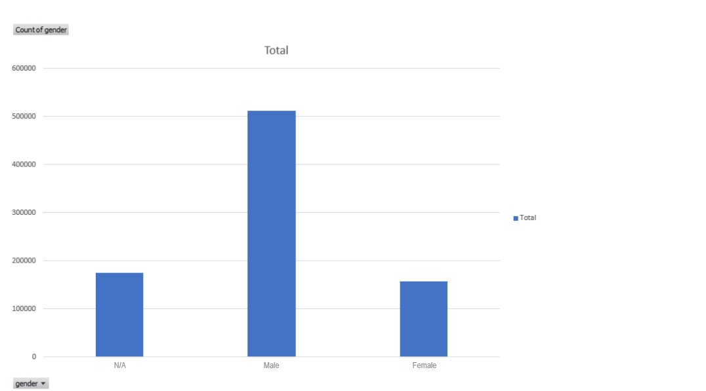
Visualization of total Gender count 07/2013

Slide 17
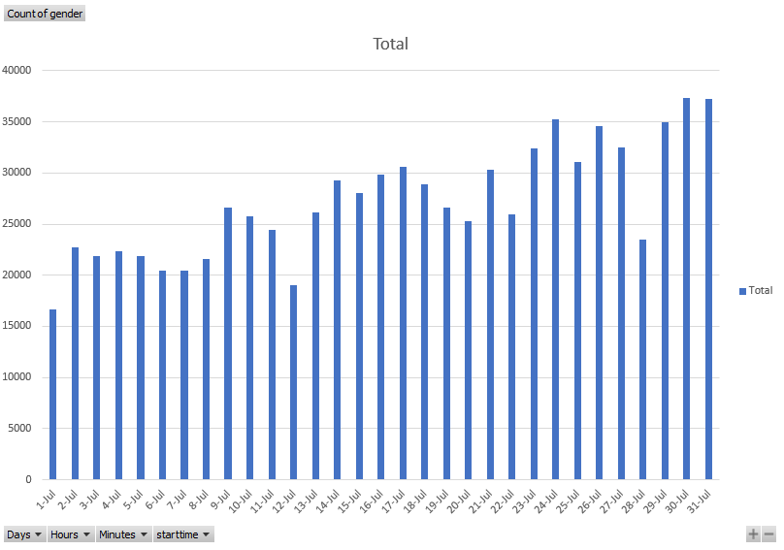
Daily Gender Count 07/2013

Slide 18
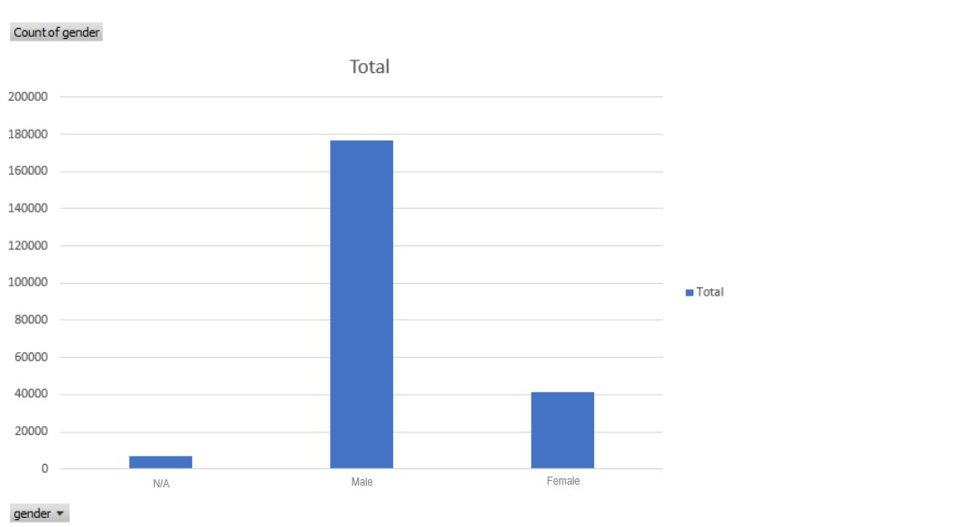
Visualization of total Gender count 02/2014

Slide 19
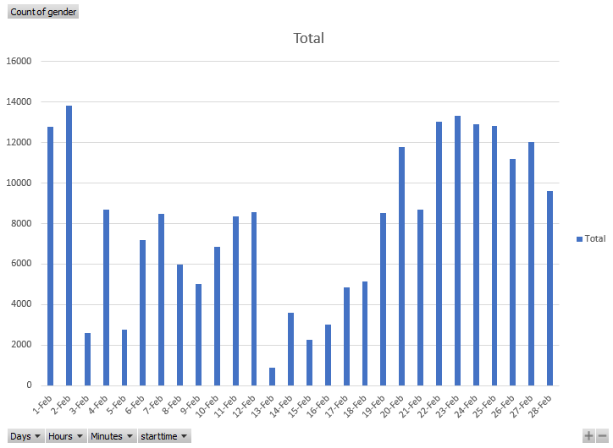
Daily Gender Count 02/2014

Slide 20
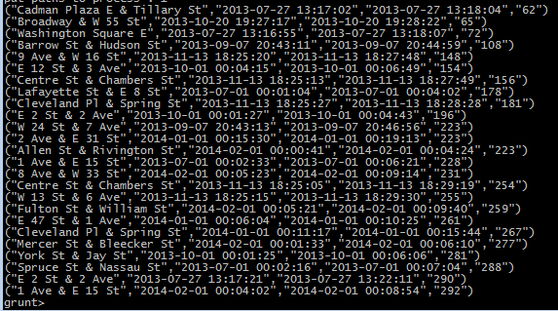
Pig Grunt Analysis and Data

Slide 21
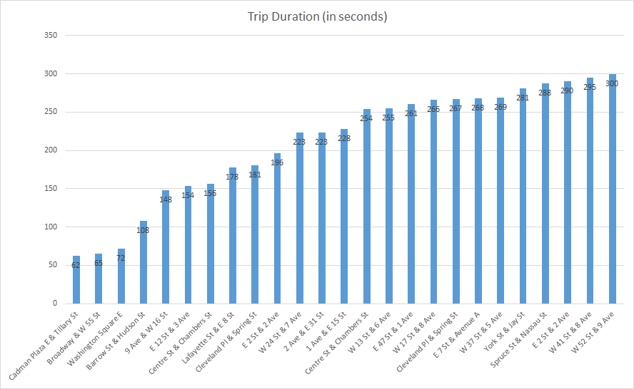
Pig Analysis and Data

Slide 22
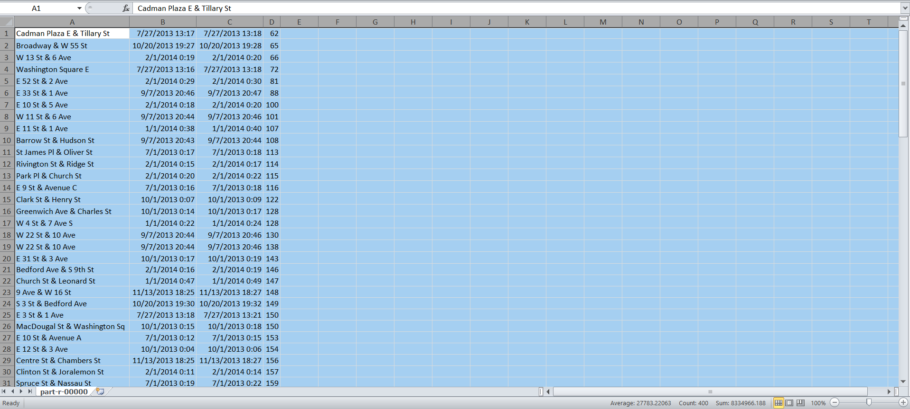
Simplification and Grouping of Data

Slide 23
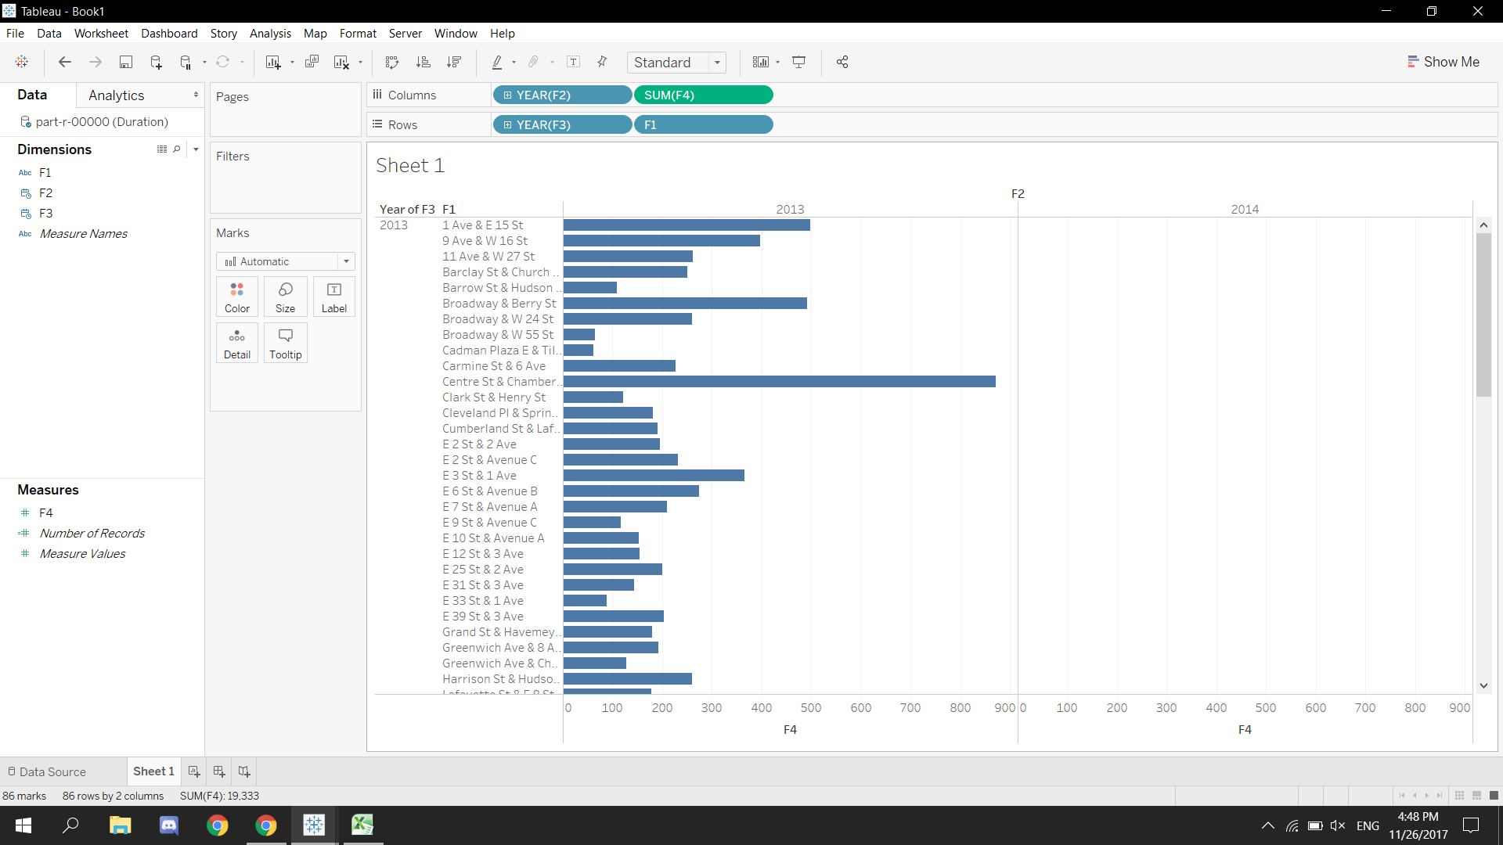
Virtualization of Citi Bike Services in 2013

Slide 24
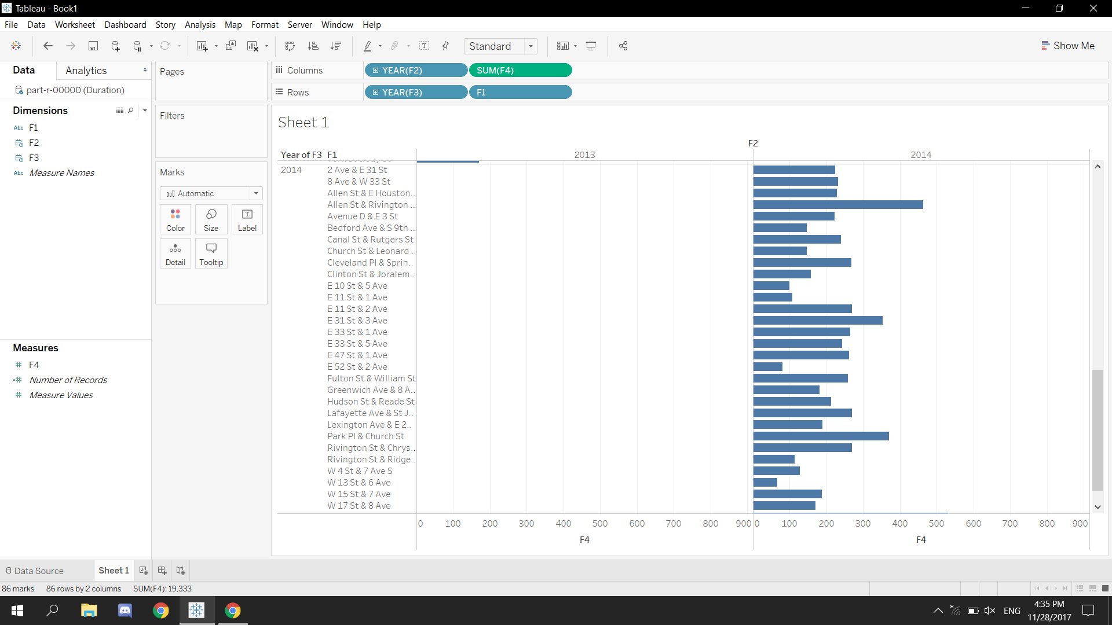
Virtualization of Citi Bike Services in 2014

Slide 25
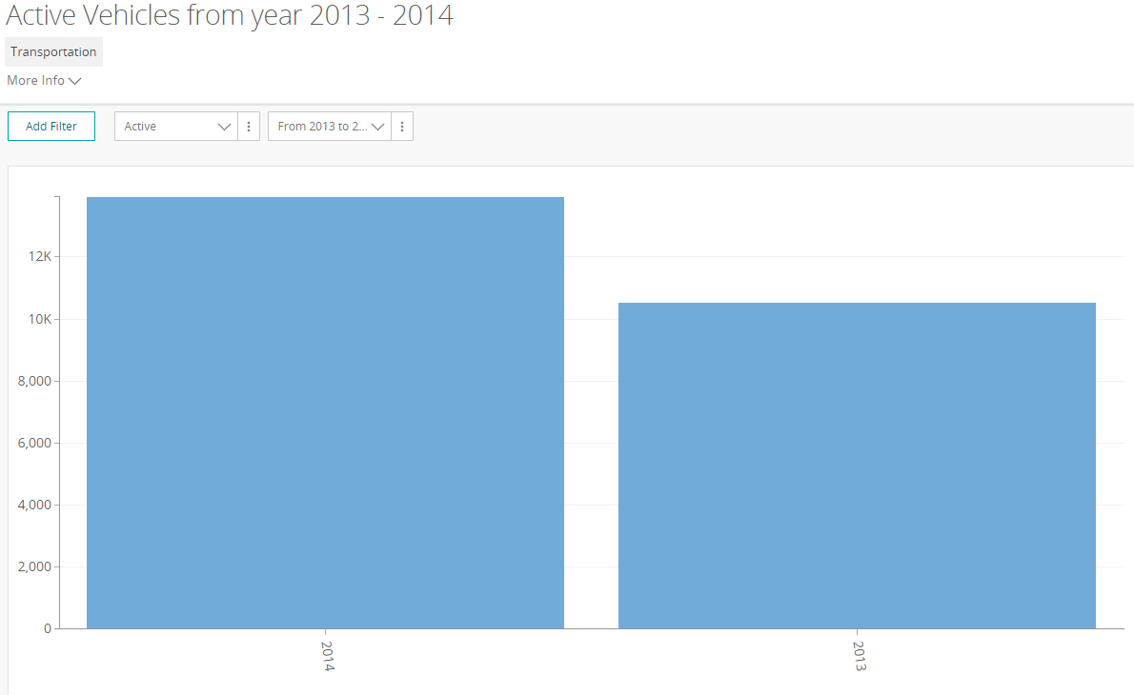
Car for Hire Visualization

Slide 26
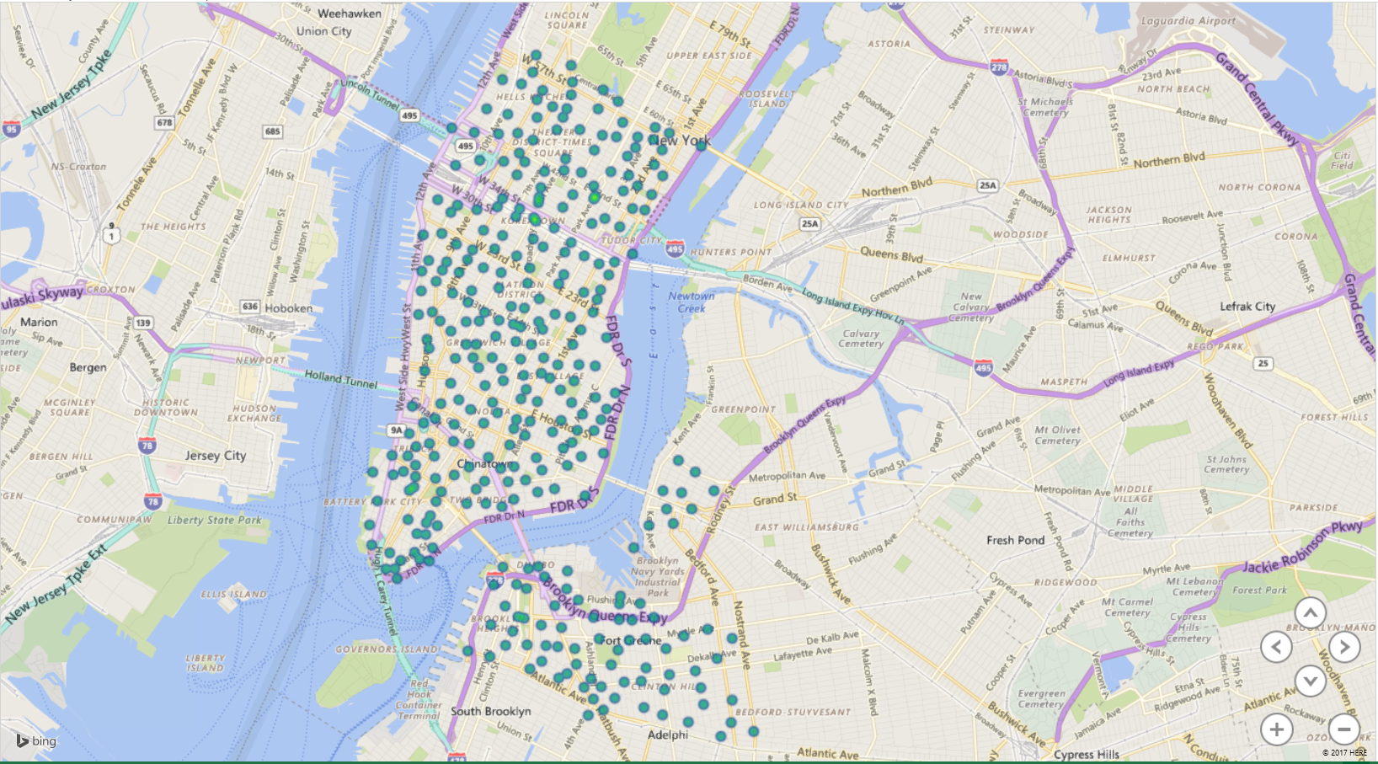
Geospatial Visualization

Slide 27
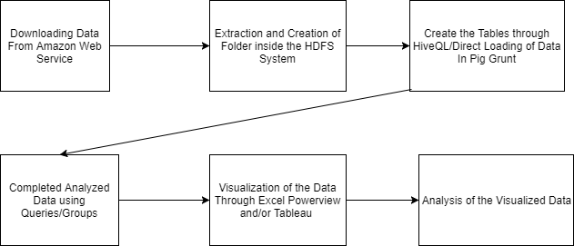
Flowchart of Data Analysis

Slide 28
Final Thoughts and Conclusion of Analysis
From this analysis we have found the where people where the stations are located, how long they ride, and what are the most popular stations.
We have also found out the correlations between the Citi Bike service in New York and the nearby Taxi service.

Slide 29
Other Links
https://github.com/dle31/Big-Data-Project
https://data.cityofnewyork.us/Transportation/For-Hire-Vehicles-FHV-Active-and-Inactive-Vehicles/8wbx-tsch

